Slide 1
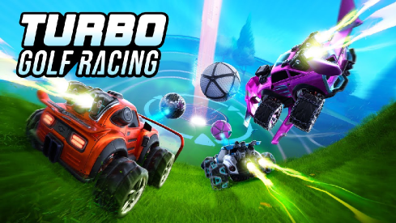
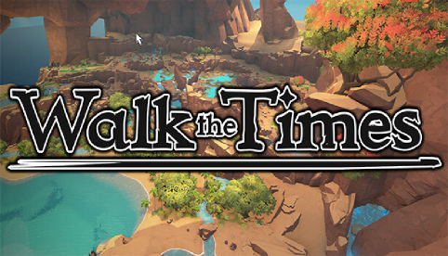
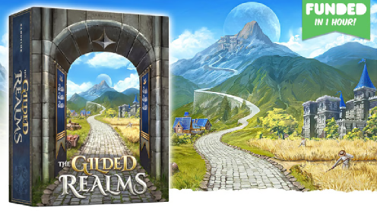
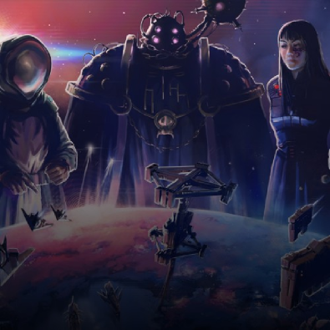
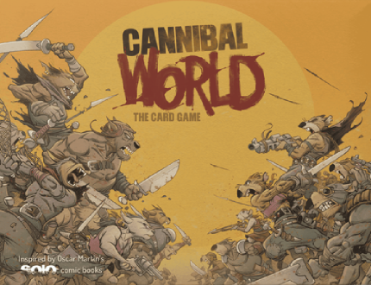
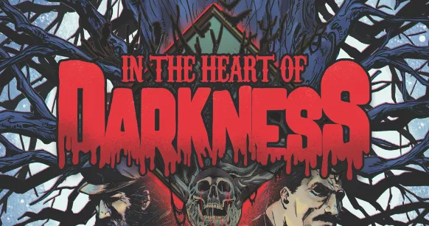
Games Ive Worked On
Senators Of Sol

Slide 2
QA, Design and Playtesting
On this game, i mostly QA’ed beta branch before it was released, and got given new maps, or checking if patches are good. Found many Map issues with unintentional map routing, or ways to get around or through map features. Suggested way to fix this, or ways to change the map to get those issues polished. Gave map suggestions or power suggestions for the game.

Slide 3
QA, Playtesting and Design Consultancy
Got given the game as a design consultant, to ask what to do next or what can be added to fix / continue with the game. During playing found many bugs, issues and design areas that could be worked on or continued to fix the issues brought up.

Slide 4
Playtesting and QA
Play tested game for multiple sessions with multiple classes getting familiar with the game then gave opinions on rulebook, game features and gameplay, to allow creators to help develop game. Gave opinions on changes that could be made in the game better, or fix to make game better.

Slide 5
Playtesting and QA
Play tested game for multiple sessions with multiple classes getting familiar with the game then gave opinions on rulebook, game features and gameplay, to allow creators to help develop game. Playtested DLC before release, as to check if it was suitable or able to be published alongside, or change it to make it more interesting for the game.

Slide 6

Playtesting, QA and Design Suggestions
Playtested and QA’ed Game and gave design suggestions Currently under NDA

Slide 7
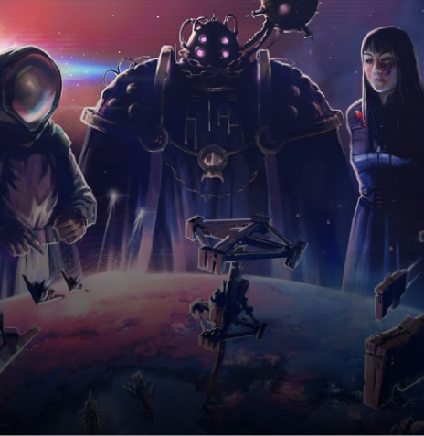
Playtesting, QA and Design
Play tested Card game + MOBA style game for multiple sessions with multiple classes in beta. Gave Both ability and card ideas to further the game development and create an interesting way to continue developing the classes in the right direction. Helped Give direction to classes and champions for the Development team.
Senators Of Sol

Slide 8
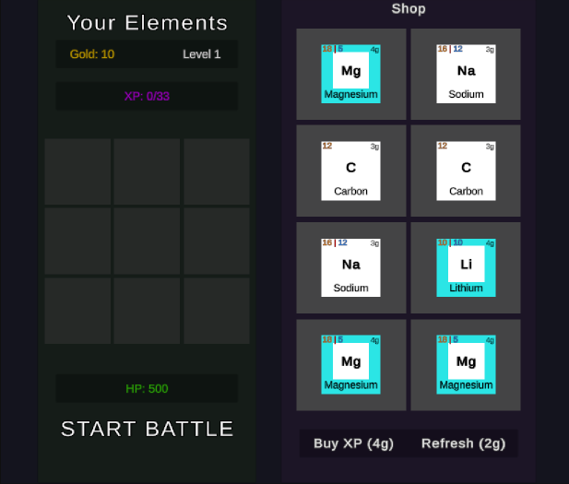
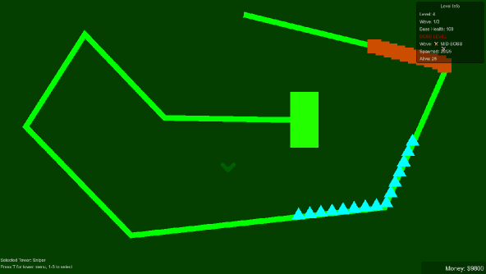
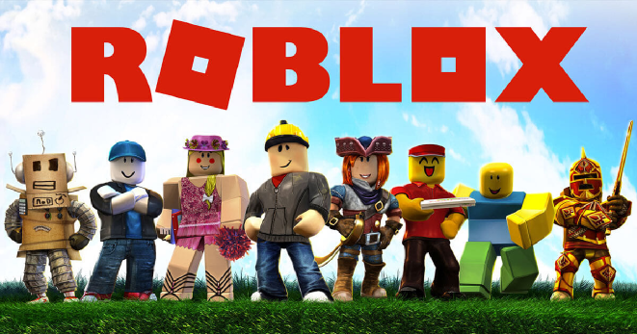
My own solo projects

Slide 9
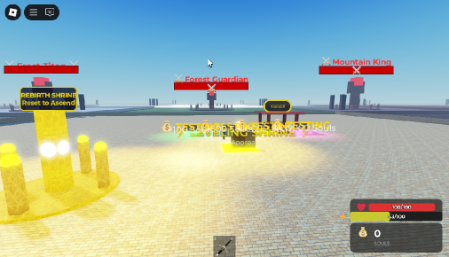
Roblox RPG
Made a simple RPG game with health, money, stamina, and rebirths Got to a development stage of creating full working system and a simple AI for enemies, but not having the ability to create Assets for the game.

Slide 10

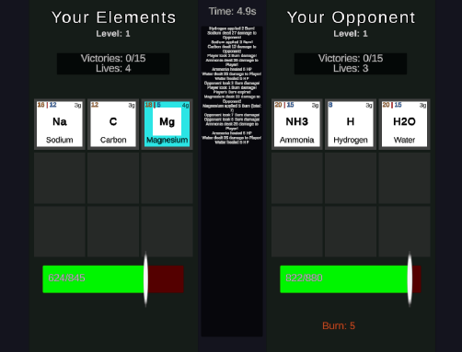
Element Wizard - Autobattler
Current Development - a game based on games ive enjoyed myself, an auto battled about combining elements to create bigger elements. Like grabbing 2 hydrogen’s and 1 oxygen to create water and battle. At the stage of needing a balance, polish and assets.

Slide 11
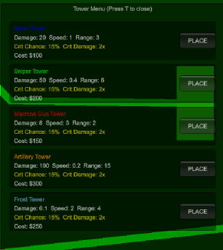
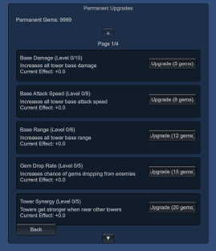
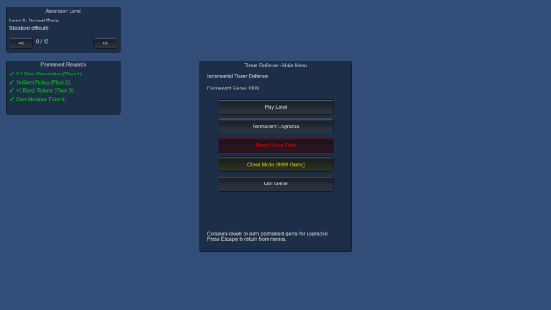
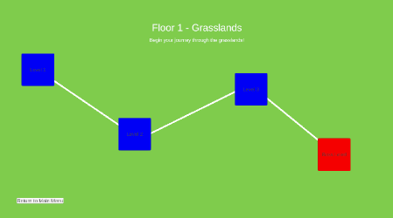

Unity Tower defence
First Unity project, to understand the engine, created a simple rouglite tower defence with towers killing enemies, and dropping crystals, to then upgrade the towers with said crystal. These crystals/gems can then be converted to permanent upgrade and help you get through the game. Requires assets, polish and a way to increase replayability.

